Slide 1
Design Patterns

Slide 2
Creation Patterns

Slide 3

Singleton

Slide 4
Problem
Solves 2 Problems:
Ensure that a class has just a single instance.
e.g. Access to a single resource like a database or file
Provide a global access point to that instance.
Replace Global Variables
Access class anywhere in the application
Notes:
Note that this behavior is impossible to implement with a regular constructor since a constructor call must always return a new object by design.

Slide 5
Solution
- Make the default constructor private, to prevent other objects from using the new operator with the Singleton class
- Create a static creation method that acts as a constructor
Calls the private constructor to create an object and saves it in a static field.
All following calls to this method return the cached object.

Slide 6
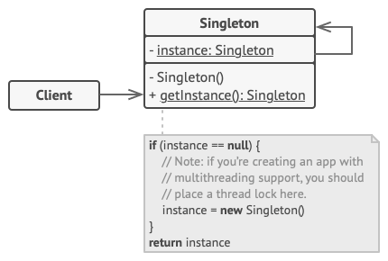
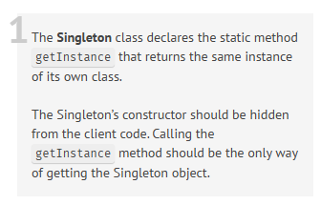
Structure

Slide 7
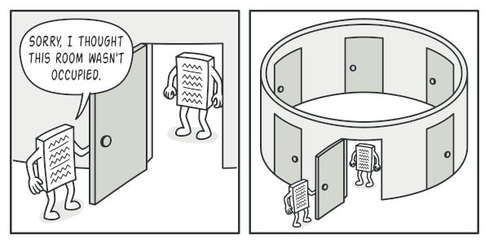
Analogy
Clients may not even realize that they’re working with the same object all the time.

Slide 8
When to Use Singleton
Use the Singleton pattern when a class in your program should have just a single instance available to all clients
e.g. a single database object shared by different parts of the program.
Use the Singleton pattern when you need stricter control over global variables.

Slide 9
Pros and Cons
Pros
You can be sure that a class has only a single instance.
You gain a global access point to that instance.
The singleton object is initialized only when it’s requested for the first time.
Cons
Violates the Single Responsibility Principle. The pattern solves two problems at the time.
The Singleton pattern can mask bad design.
The pattern requires special treatment in a multithreaded environment so that multiple threads won’t create a singleton object several times.
It may be difficult to unit test the client code of the Singleton because many test frameworks rely on inheritance when producing mock objects.

Slide 10
Factories
Factory
Abstract Factory
Factory Method
Factory, Abstract Factory, Factory Method - Design Pattern (C#)
Notes:
Abstract Factory - Shared interface but different implementations
Factory Method – Creating methods in an abstract class – Defines Utility

Slide 11
Builder
Builder Design Pattern Explained in 10 Minutes
Notes:
Separate Representation from Construction
Leave responsibility to the Builder

Slide 12
Prototype
https://www.youtube.com/watch?v=fqaoCDyxb1w
Notes:
Seems to differ from the Builder / Factory by cloning the state of any particular object
Kind of like a dynamic Director class that is the builder or a dynamic factory

